Slide 1
Evaluation in Practical Field:
Dr. Shankar Chatterjee
NIRD &PR, Hyderabad-500 030, Telangana, India
E-mails: shankarjagu@gmail.com & shankar_nird@yahoo.com

Slide 2
Programme & Project
Programme is an organized set of activities ,project, processes or services which is oriented toward the attainment of specific objectives.
Project is a planned undertaking which is a set of interrelated & coordinated activities designed to achieve certain specific objectives within a given Budget & Time period.
(Source: M& E Guiding Principles, UNACC Task force on RD, 1984)

Slide 3
STEPS OF PROJECT PREPARATION
PROJECT Preparation 6 steps plus 4 sub-steps
1. IDENTIFICATION
2. FORMULATION/PREPARATION
3. APPRAISAL (4 sub-steps)
Economic Viability
Technical Feasibility
Social Acceptability
Environmental Sustainability
4. IMPLEMENTATION
5. MONITORING
6. EVALUATION

Slide 4
EVALUATION
Evaluation: Process for determining systematically and objectively the relevance, efficiency, effectiveness and impact of activities in the light of their objectives. It is an organizational process for improving activities still in progress and for aiding management in future planning, programming and decision making.
Source : M&E Guiding Principles, 1984, UNO

Slide 5
Types of Evaluation
1. Ongoing
2. Terminal
3. Ex-post
Ongoing evaluation examines whether the assumptions or hypotheses made during the project formulation/ appraisal stage are still valid, or whether adjustments are required to ensure that the overall project objectives will be achieved.
Source : M&E Guiding Principles, 1984, UNO

Slide 6
Evaluation continued
Terminal evaluation is undertaken from to 6 to 12 months after project completion
Ex post evaluation is undertaken after full project development i.e. some years after project completion
Source : M&E Guiding Principles, 1984, UNO

Slide 7
“Dos and don´ts” in relation to use of evaluation questions
Source: CAPTURING THE SUCCESS OF YOUR RDP: FOR THE EX POST VALUATION OF 2007-2013 RDPS GUIDELINES , European Evaluation Network for RD, June 2014, European Commission
Dos Provide answers transparently so that the judgment can be traced back to the chosen method and evidence on which the answers are based. | DON’Ts Provide answers to the EQs without reference to the evidence base and the methods by which the analysis has been conducted.
Develop programme-specific evaluation questions if common set does not address all evaluation needs. | Rely only on common evaluation questions.
Specify the success of the intervention for each of common and programme-specific evaluation questions using the judgment criteria. | Be silent about judgment criteria.
Check the consistency of each of the evaluation questions with judgment criteria and indicators. | Forget about linking programme-specific evaluation questions to indicators.
If inconsistencies and gaps are identified, reconstruct the missing or misleading parts to re-establish consistency. | Overlook consistency gaps between policy objectives, EQs, judgment criteria and indicators.
Apply the proportionality principle and invest relatively more in-depth analysis concerning the EQs which address areas of strategic priority and larger budgetary endowment. | Explore all evaluation questions in the same level of detail, regardless of the importance they have within the whole RDP.

Slide 8
MEAT
Staff (No. of trained staff /non trained staff others, if require)
Finance
Mechanism (supervision, inspection, meeting etc)
Flow of information (Time)
Equipment (Machine, Materials etc)
Others (misc.)

Slide 9
Concern
In designing the layout of the Questionnaire/Schedule, leave enough space for responses to open-ended questions but at the same time keep such questions to a minimum if possible.
Difficulty in getting a useful response rate (not everybody returns the questionnaire).
Open ended questions are more difficult to categorize.
Responses may be based on the more memorable events (either good or bad).
Necessary to keep the questions focused and to ask the right kind.

Slide 10
PM & E
It is an approach which involves local people, development agencies & policy makers deciding together how PROGRESS should be measured & results acted upon. It helps to improve accountability.
[source – IDS, SUSSEX, UK.1998]

Slide 11
P M & E
Participatory M & E is a different approach which involves local people, development agencies, & policy makers deciding together how these progress should be measured & results acted upon.

Slide 12
DIFFERENCE – CME & PME
 | CME | PME
Who plans & manages process | Sr. Managers or outside experts | Local people, project staff, managers & other stake holders
Role of “primary stake holders” (intended beneficiaries) | Provide information only | Design & adapt the methodology, collect and analyze data, share findings and link them to action
How success is measured: | Externally- defined, mainly quantitative indicators | Internally- defined indicators, including more qualitative judgments
Approach: | Predetermined | Adaptive
Source- I D S, SUSSEX ( November 1998)

Slide 13
Meaning of Indicator
Indicators are variables that help to measure changes in a given situation.
They are tools for Monitoring & Evaluating of an Activity.
Indicators Specific (explicit) & Objectively Verifiable Measures.
Input Indicators, Output Indicators, Effect Indicators & Impact Indicators.
Input: use of fertilizer (kgs); Output: Area in hectares; %age of farmers new extension package (effect i.e. Adoption rate) and Change in Income (Impact)
(Source: M& E Guiding Principles, UNACC Task force on RD, UNO 1984)

Slide 14
Direct & Indirect Indicators
Indicators may be DIRECT as mentioned in the previous slide.
Indirect indicators are used where Direct measurement not feasible.
e.g. Land holding size, type of house etc., for economic assessment of the villagers.
Choice of Indicators are based on following
VALID: they should actually measure what they are supposed to measure.
RELIABLE: That is VERIFIABLE.
RELEVANT: relevant to project objectives.
SENSITIVE: Sensitive to changes in the situation.
SPECIFIC: Specific to the objective.
COST EFFECTIVE:
TIMELY: With stipulated time data should be collected
(Source: M& E Guiding Principles, UNACC Task force on RD, UNO 1984)

Slide 15
Types of indicators
Baseline indicators
Input indicators
Output indicators
Result indicators
Impact indicators
Source: CAPTURING THE SUCCESS OF YOUR RDP: FOR THE EX POST VALUATION OF 2007-2013 RDPS GUIDELINES, European Evaluation Network for RD, June 2014, European Commission

Slide 16
Concept of Indicators
Baseline indicators: Baseline indicators are those used to assess the starting point of the programme, and provided the basis for the SWOT analysis and definition of the programme strategy.
Input indicators: These refer to the budget or other resources allocated at each level of the assistance.
Output indicators: These measure activities implemented within various measures of the programme.
Result indicators: These measure the direct and immediate effects of the intervention. They provide information on changes in, for example, the behaviour, capacity or performance of direct beneficiaries and are measured in physical or monetary terms.
Source: CAPTURING THE SUCCESS OF YOUR RDP: FOR THE EX POST VALUATION OF 2007-2013 RDPS GUIDELINES , European Evaluation Network for RD, June 2014, European Commission

Slide 17
Indicators
Impact indicators: These refer to the benefits of the programme both at the level of the intervention but also more generally in the programme area. They are linked to the wider objectives of the RDP.
Impact indicators are perhaps the most important of all in assessing the success of the RDP.
However, they cannot be understood in isolation, and in order to explain observed outcomes, reference may need to be made to output and result indicators.
Example: increase in employment in rural areas, increased productivity of agricultural sector, increased production of renewable energy.
Source: CAPTURING THE SUCCESS OF YOUR RDP: FOR THE EX POST VALUATION OF 2007-2013 RDPS GUIDELINES , European Evaluation Network for RD, June 2014, European Commission

Slide 18
Example of M&E data at Household level
Source: M& E Guiding Principles, UNACC Task force on RD, UNO 1984)
Income (Direct)
Assets (proxy), e.g. house, land, livestock, durable households goods etc.
Food Consumption: Normal & special
Clothing:
Employment : Type, No. of days
Health and Sanitation:
Education:
Membership in other organizations:
Role of women in development:

Slide 20
Time Line Showing Crops Grown Before & After Irrigation Project at Tambewadi Village, Pathardi Block, Ahmednagar district, Maharashtra
My Evaluation Study (Main Indicators) :
9 SHGs were formed with 49 members having land under SGSY of (GoI)- Indicators social and economic Particulars
Each SHG was given Loan & Subsidy- Amount of Loan & Amount of Subsidy/INPUT
Their Knowledge about Repayment of Loan and Activities. And also how they Utilized the money? (crop production etc) /OUTPUT.
Marketing of their Goods/EFFECT
Major Outcome, Quality of Life etc/ IMPACT

Slide 21
Time Line Showing Crops Grown Before & After Irrigation Project at Tambewadi Village, Pathardi Block, Ahmednagar district, Maharashtra ( study in 2002 & 2010 & Project Started in 2000)
Irrigation available 55.88 Ha. (100%)
Before Project After Project
Kharif : Kharif :
Bajra , Groundnut Groundnut, Dal, Bajra
Vegetables etc.
Rabi crops – Jowar, Onion Rabi crops :Wheat, Vegetables, Onion Other Crops: NIL Other Crops:
Cash crops: Sugarcane
Horticulture: Banana,
Pomegranate

Slide 22
Karnataka & SKDRDP
An NGO, viz. Shri Kshethra Dharmasthala Rural Development Project (SKDRDP) financing/guiding small and marginal farmers by forming self-help groups viz., ‘Pragatibandhu’ (PBG)NGO- Model.
Evaluation study divulges Quality of Life scaled up.

Slide 23
Progress of ‘Pragathibandhu’ since inception to 2013-14
(Rs. in Crore) : Case from Karnataka
Sl No | Performance | 2013-14 | Since inception to 13-14
1. | Groups formed | 758 | 51,784
2. | families involved | 12,162 | 2,70,909
3. | Savings mobilized(Rs. in Crore) | 3.39 | 122.25
4. | Loans disbursed to the members
 | Numbers | 11,941 | 8,16,128
 | Amount (Rs. in Crore) | 53.45 | 1,115.81
5. | Amount recovered(Rs. in Crore) | 43.55 | 776.63
6. | Labour sharing
 | No. of Man days | 1088200 | 48913477
 | value @RS.150/- per day (Rs. in Crore) | 16.32 | 733.70

Slide 24
Progress of ‘Pragathibandhu’ : Case from Karnataka
My Evaluation Study (Main Indicators) :
Socio-economic particulars of the farmers.
Type of Owned Land (Area in Acre)
Total non-irrigated &irrigated area (Acre)
Cropping Pattern, Production
No. of times loan taken & total amount
Socio-economic condition before & after intervention (PBG)
Total Income
Assets Created

Slide 25
Village: Machina, Taluk – Belthangady
PBG: Marakkada B; No. of members : 5 ; Age of the SHG:12 Years
Savings of the members : Rs. 35,380.00
No. of labour sharing day : 3219
Value of labour shared: Rs. 2,41,425.00
Sl. No. | Name of the member | Land owned (Acres) | Crops grown | Loan availed (Rs.) | Purpose of the loan
1. | Dombayya sherigar | 5 | Areca nut, coconut, cashew, vegetables | 99,000.00 | Solar lamp purchase, house repair, areca nut, repayment of loans, Education (Tailoring)
2. | Monappa Gowda | 2.5 | Areca nut, coconut, Vegetables | 26,000.00 | Piggery, house repair, loans repayment
3. | Sundara Poojari | 2 | Areca nut, coconut, vegetables | 30,000.00 | Pump purchase, Jeep purchase
4. | Pramod Gowda | 0.5 | Areca nut, coconut | 50,000.00 | Pump purchase, construction of cow shed, gold purchase
5. | Dharrnappa Gowda | 2.5 | Areca nut, coconut, Cashew, vegetables | 20,000.00 | Construction of cow shed, compost purchase

Slide 26
Village: Mundur Village, Taluk:Belthangady
Name of the Pragathibandhu SHG : Kalyaradda
No. of members involved : 5
Age of the SHG : 16 Years
Savings of the members : Rs. 47,460.00
Total Labour Sharing days : 4080
Sl. No. | Name of the member | Land owned (Acres) | Crops grown | Loan availed (Rs.) | Purpose of the loan
1. | Chindananda Poojari | 1.5 | Areca nut, Coconut, Paddy | 73,590.00 | House construction, marriage, Agri development
2. | Sundara Poojari | 1.5 | Areca nut, Coconut, Paddy | 76,585.00 | Daughters marriage, Pump Purchase, Agri development, well repair, Cattle Shed repair
3. | Alex Vegus | 1.50 | Areca nut, Coconut, Rubber, Jasmine | 1,13,745.00 | Vehicle purchase, Jasmine cultivation , life insurance, well repair
4. | Somappa Poojari | 1 | Areca nut, Coconut | 35,480.00 | House repair, Medical, Cattle Shed rapair, Life Insurance
5. | Rajendra Poojari | 1.50 | Areca nut, Coconut, paddy | 1,24,855.00 | House repair, Well repair, marriage, life insurance

Slide 27
Village: Odilnala village, Belthangady Taluka
Name of the Pragathibandhu SHG : Mairalike-A
No. of members involved : 6
Age of the SHG : 16 Years
Savings of the members : Rs. 49,650.00
Total Labour Sharing days : 5630
Sl. No. | Name of the member | Land owned (Acres) | Crops grown | Loan availed (Rs.) | Purpose of the loan
1. | Jayanand Nayak | 6 | Areca nut, Coconut, Rubber, Banana, Pepper | 2,87,805.00 | Agri development, Rubber, Dairy, Solar light installation, Gobar Gas
2. | Shyamanna Naik | 4 | Areca nut, Coconut, Banana, vegetables | 1,98,280.00 | Agridevelopment, Rubber, Diary, Solar light installation, Gobar Gas, Washing machine purchase
3. | Vamana Mulya | 4 | Areca nut, Coconut, Banana | 2,11,301.00 | Agri development, Dairy, Solar light installation, Gobar Gas
4. | Andru D’ souza | 3 | Areca nut, Coconut, Banana | 2,86,685.00 | Areca nut cultivation, Tank construction, Pump & Pipe purchase.
5. | Vanishree | 5 | Areca nut, Coconut, Banana, Pepper | 1,29,800.00 | House repair, electrification, Vehicle purchase

Slide 28
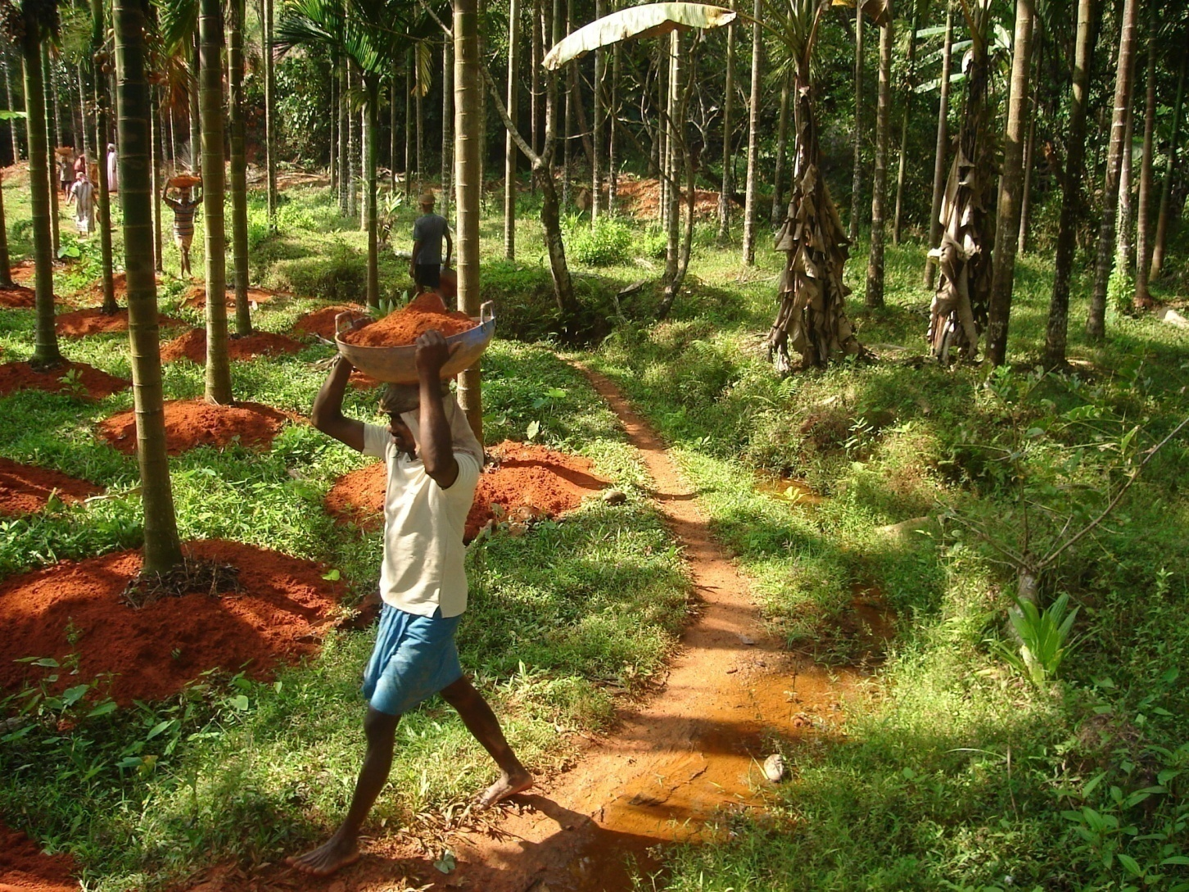
PBG in Karnataka

Slide 29
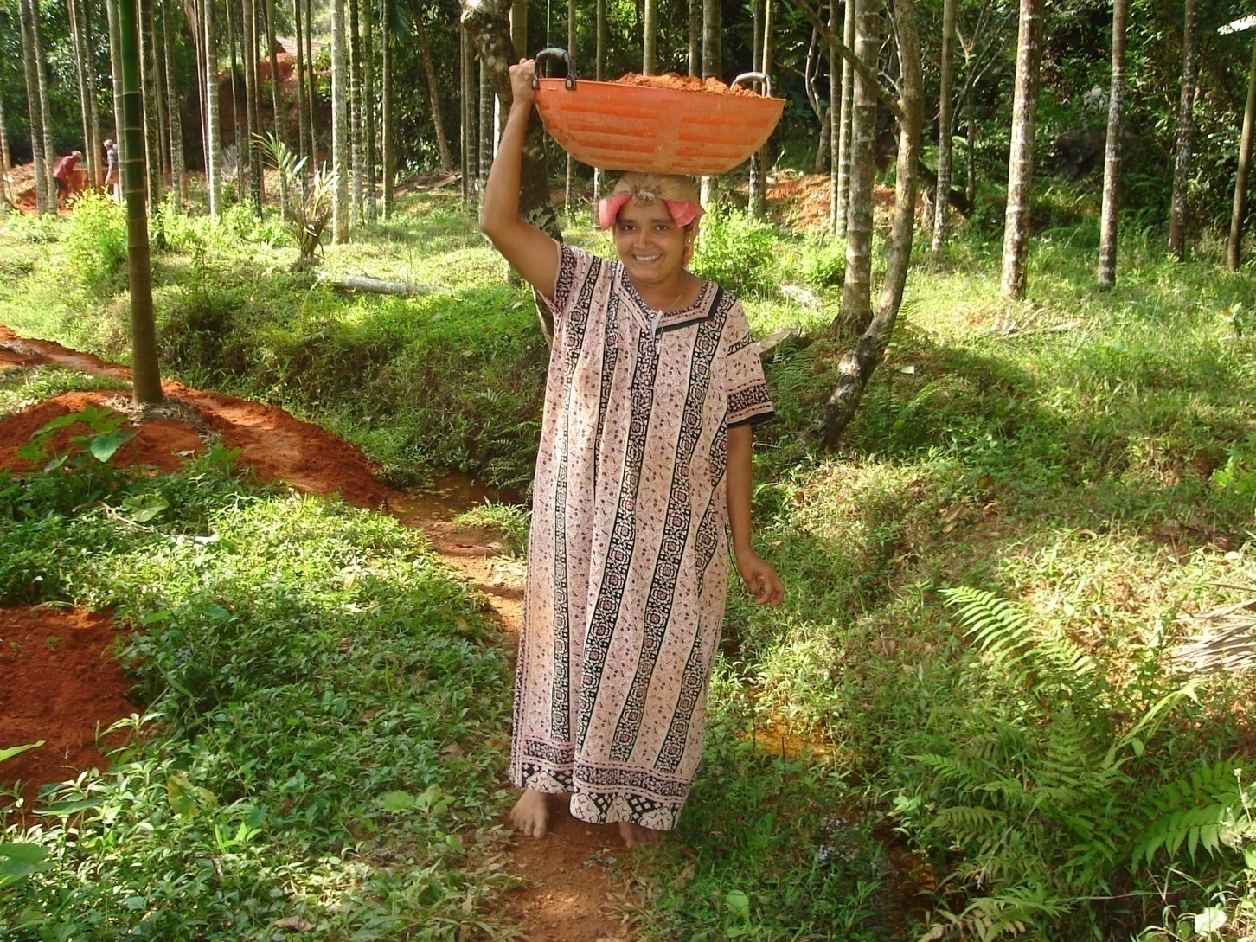
PBG in Karnataka

Slide 30
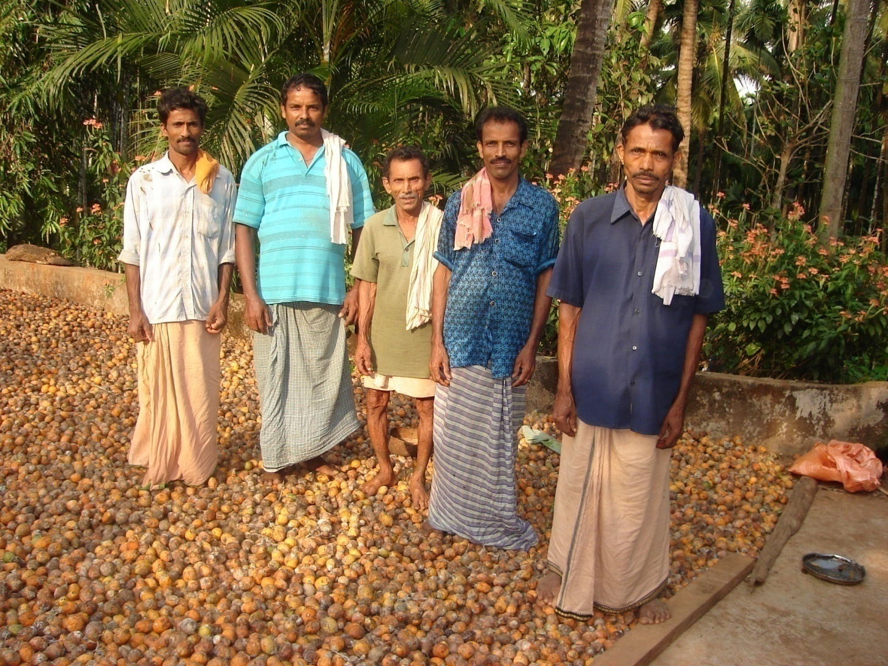
PBG in Karnataka

Slide 31
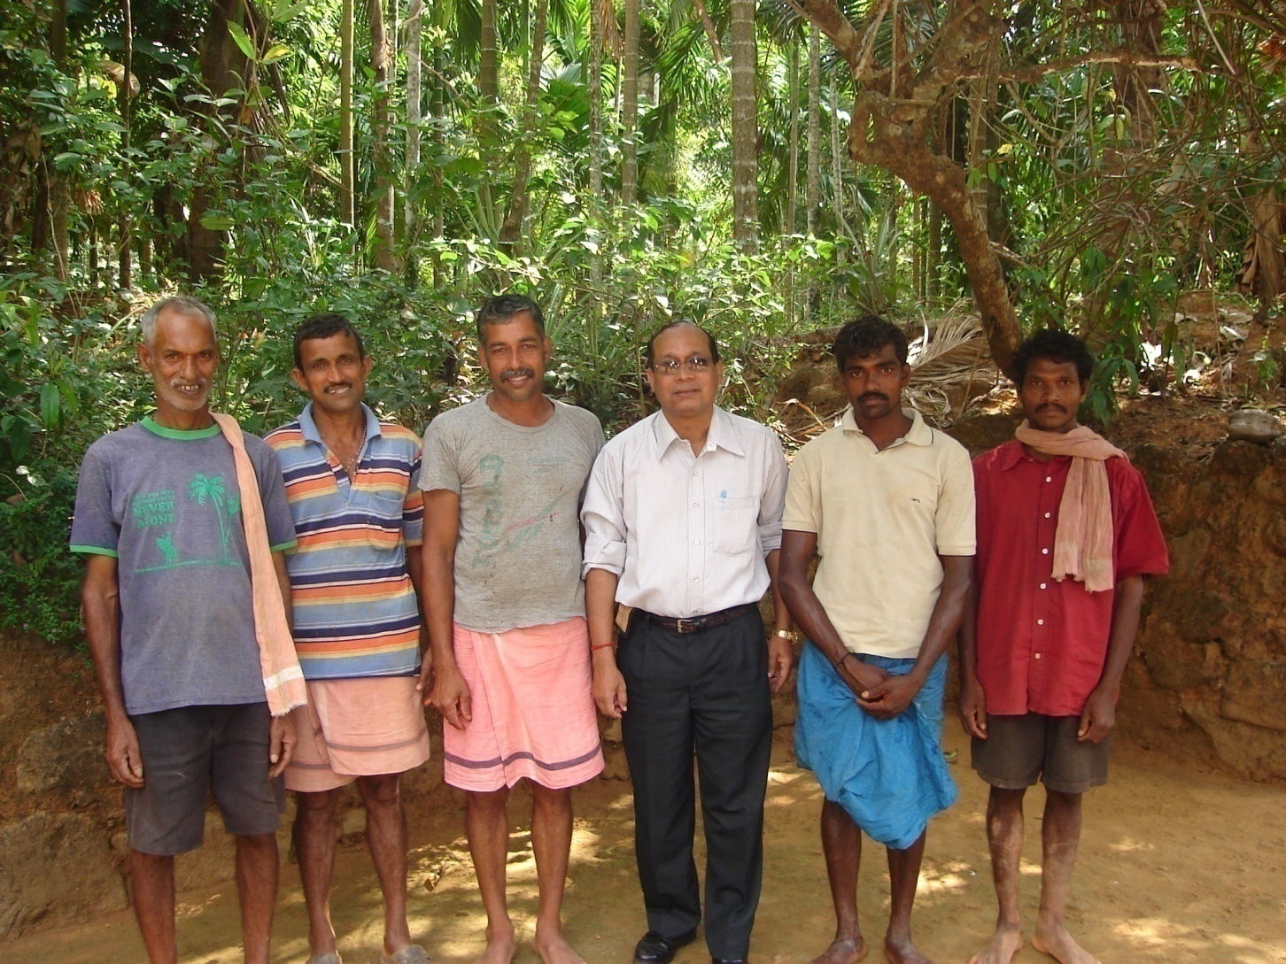
PBG in Karnataka

Slide 32
Malaysia Case
Malaysia’s Raub district, Kampung Peruas village, Pahang state.
Mr. Mustapa successful entrepreneur as early as in 1992 by setting up a tourist resort.
Started with one room (double bedded) and then 16 rooms (all double bedded)
No formal educational qualification and after his death in May 2014 his wife, daughter (quite educated and good in English) and son- in- law (studied school level) were managing with six workers.
Two children.
They stay in the Resort, Monitor and all cooking done by them
Net earning yearly RM 100,000.
Own house & stay in the resort.
All necessary Households Items are available.

Slide 33
Peru’s Case
Fovida as an NGO helping potato growing farmers.
Fovida coordinates the supply of seed potato from the producers in the Andes region to other places so that farmers are not deceived.
For betterment of farmers an Association of farmers formed and Association is mainly meant for them who grows potato and selling to `Snacks’ factory.
Many farmers thus benefitted.
(Land, Income, Spending, Assets in the house etc were considered as indicators).

Slide 34
Artichoke in Peru May 2013 at Chamiseria village of Huancayo province
Average land holding size was 1.5 hectares.
200 HHs, no landless households at the village.
Almost all grow Artichoke -8 months to grow after plantation as assured market.
In 1 Hectare around $1000 (US Dollar) can be earned.
No crop insurance in Peru (so author suggested)
Artichoke good for health particularly for diluting stone in gall bladder, kidney etc.

Slide 35
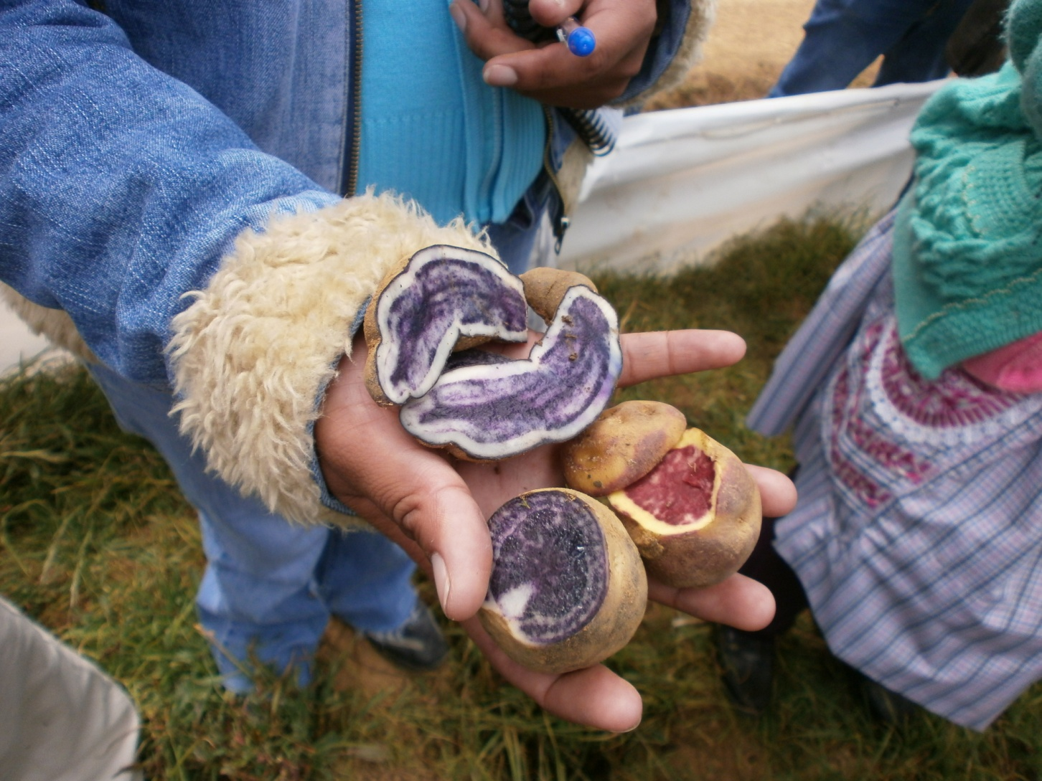

Slide 36
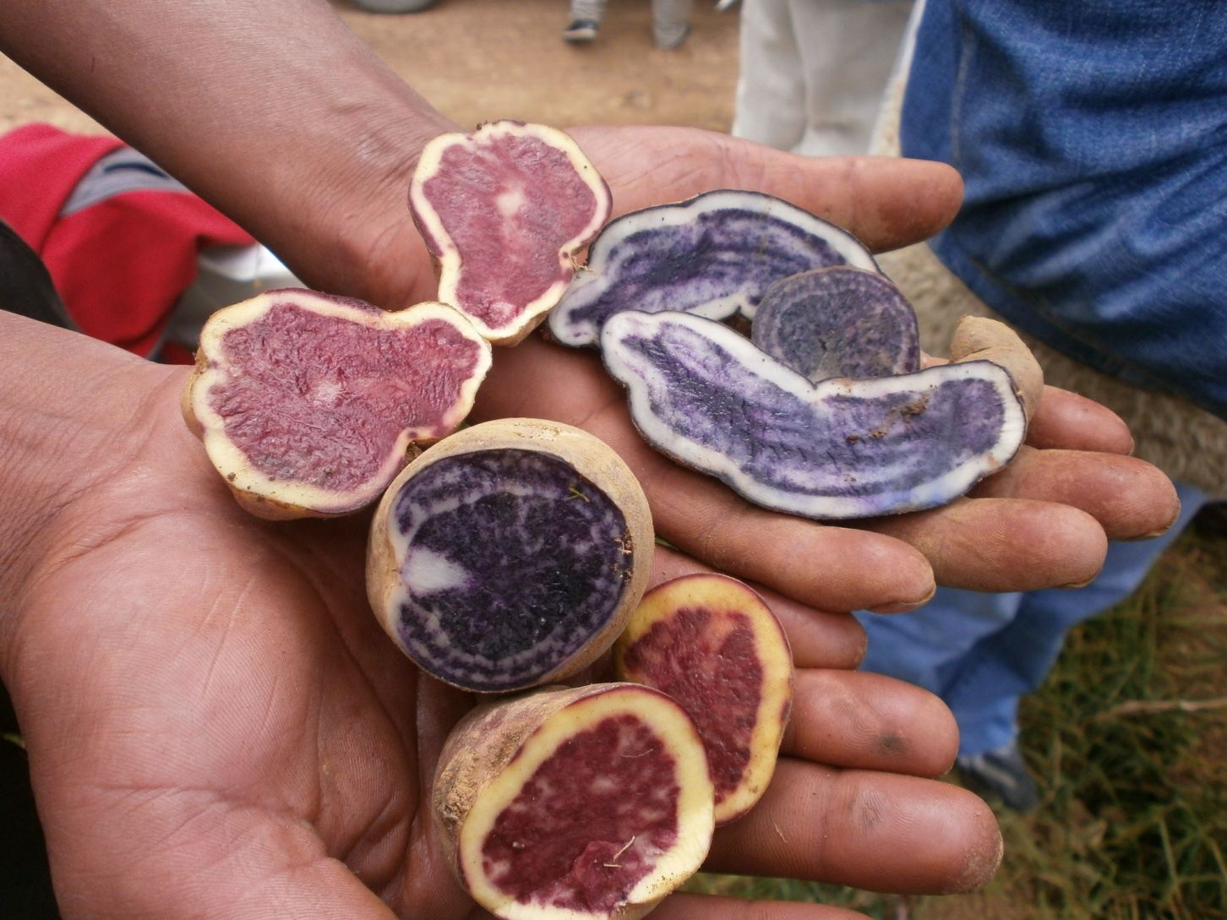

Slide 37
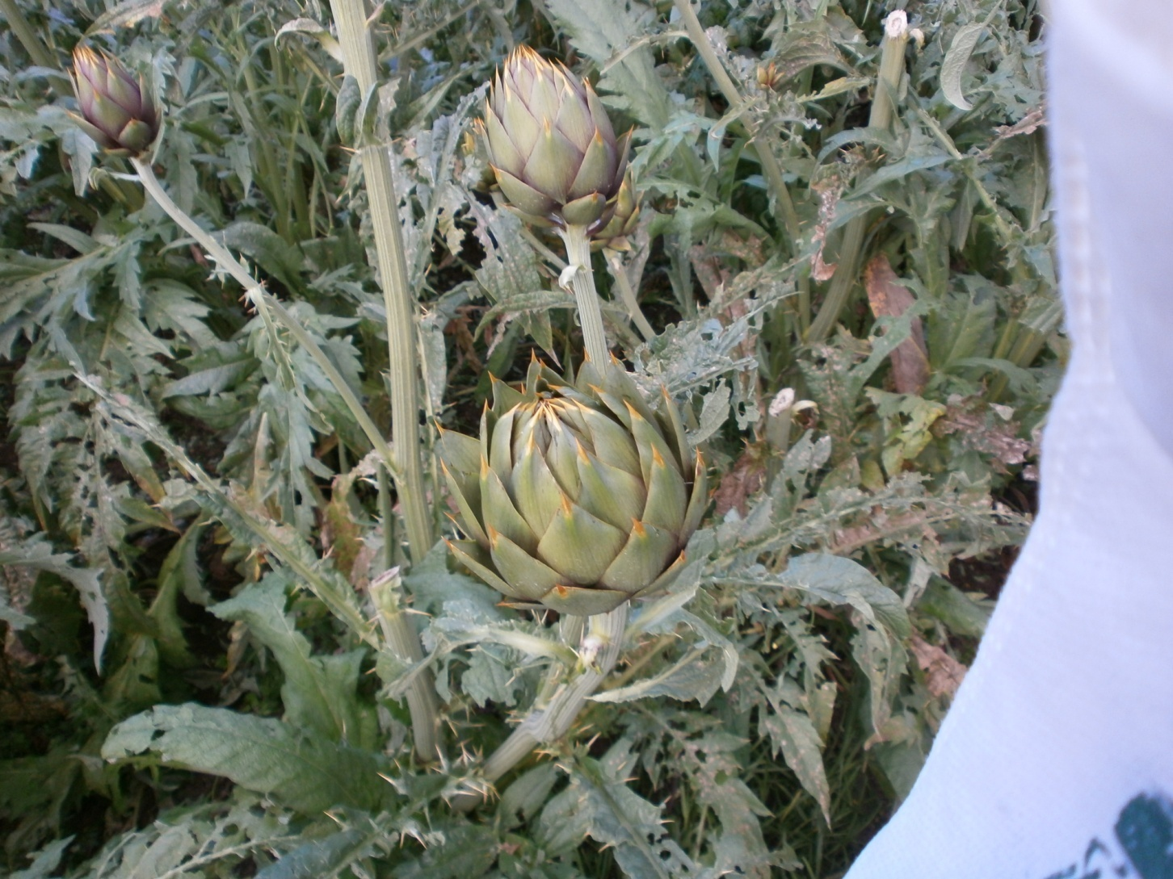
Artichoke

Slide 38
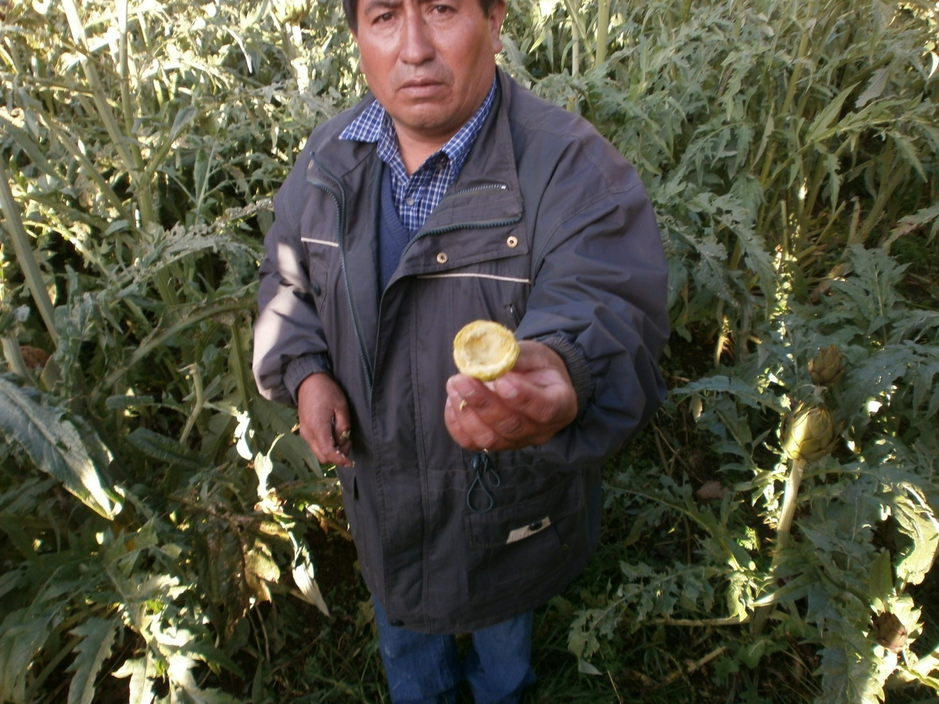

Slide 39
About Godavari Mahasamakhya , Tallarevu Mandal, East Godavari district, Andhra Pradesh
Godavari Mahasamakhya (GMS):
Godavari Mahasamakhya (GMS) a premier confederation working for poverty eradication in coastal fishermen families in the district.
GMS registered under APMACS Act 1995 & affiliated to Zilla Samakhya. The main objective -to achieve tangible development for all families.
Focus on social issues like health & hygiene, children education with special emphasis on girl child education.
GMS established training centre in 2010 at CBV Palem village of Tallarevu mandal (cluster of villages), 12 kilometers away from district headquarter.
19,733 families formed in 1781 SHGs under GMS.

Slide 40
GMS- Activities
Secured Rs 46.00 lakh from SERP (Org of Govt. of Andhra Pradesh ) & Rs. 40.00 lakh contributed/raised through resource fees by members aggregating to Rs. 86.00 lakh.
Constructed training centre (100 women can attend) for residential trainings.
Through Micro Credit Plan (MCP) 18,600 families benefited & 8,986 families got more than Rs. 1 lakh loan. Average family’s monthly income went up to Rs.7000.
7,584 families contributed @Rs. 10 each for health related expenditure & Rs.12.66 lakh was available. Accounts maintained by VO (Federation of SHGs at Village).
For higher education Rs. 54.08 lakh was sanctioned to 792 students (6% interest).
44 meritorious students for free education.
1056 children enrolled in play schools, 3-5 years age, 56 Centers.

Slide 41
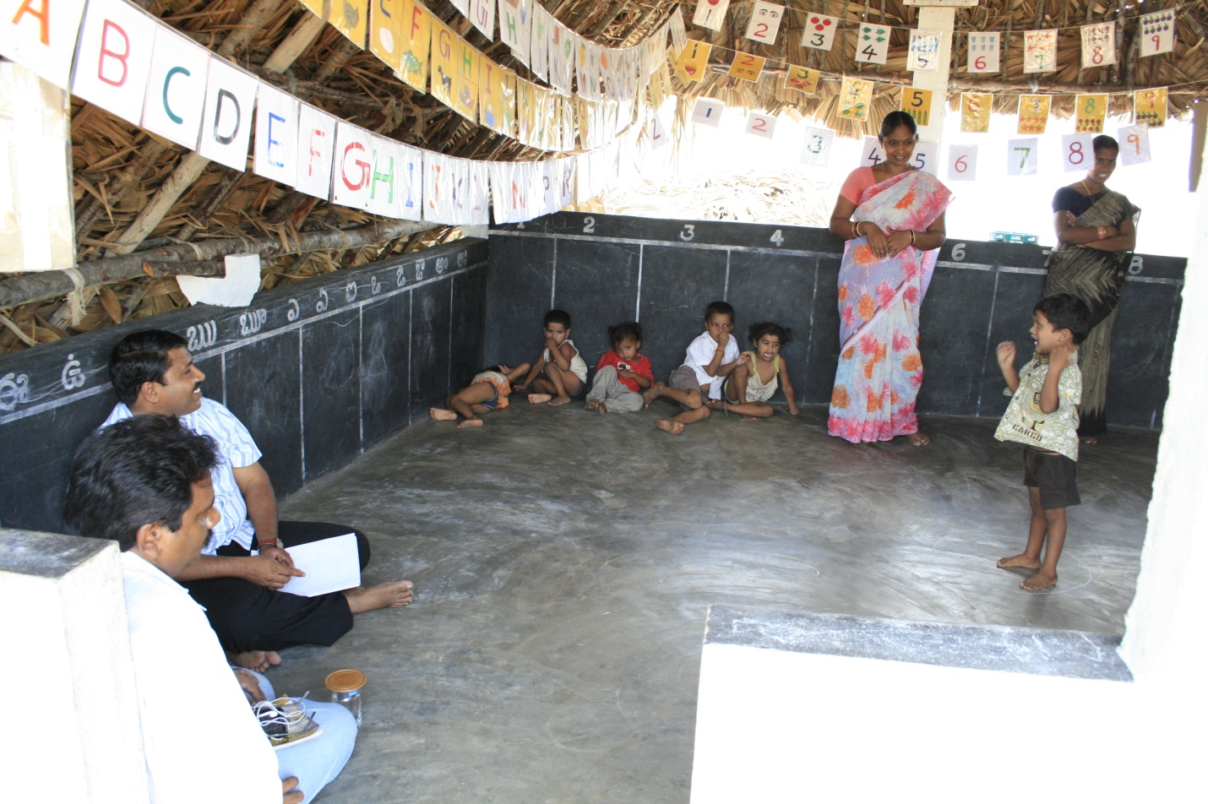
A play school

Slide 42
GMS- Activities
Practical purpose 100 Community Resource Persons (CRPs) working in other areas.
Free rice distributed to vulnerable women, each SHG member gives handful rice/day. 5 kilograms rice every month given.
Average 2000 kilograms rice given to 400 families.
For AIDS, Cancer & TB patients @Rs.200/person/month given, 32 women benefitted.
Students of IIT, Medicine, Eng., MBA, MCA & PG courses in Maths, Physics, Chemistry, Bio-Tech & Micro-Biology, scholarships given @Rs.1000 per year/student. Girl students @Rs 2000 per year.

Slide 43
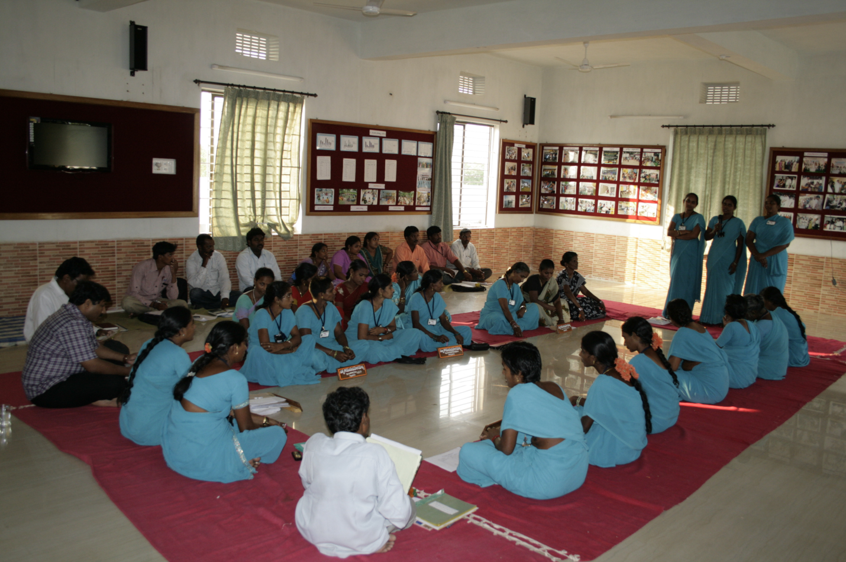
Monthly meeting of mandal federation (MS)

Slide 44
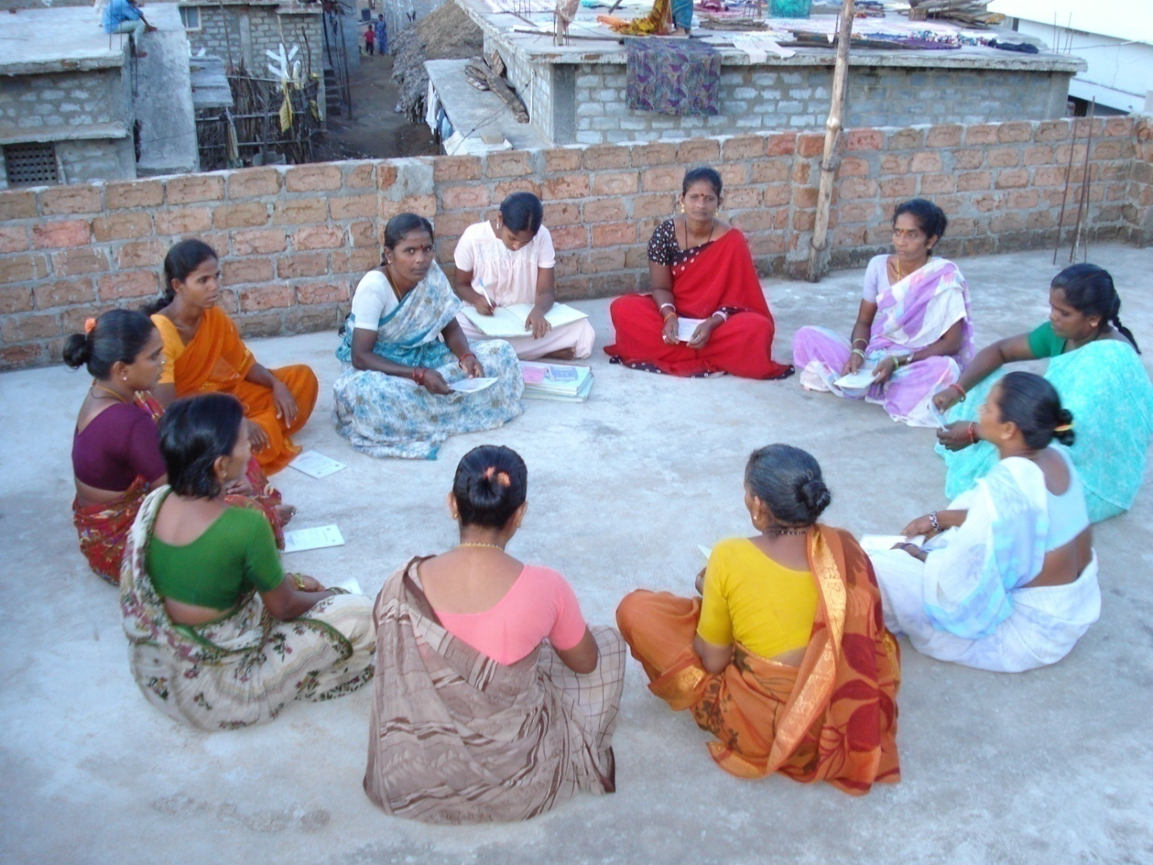
Weekly meeting of a SHG

Slide 45
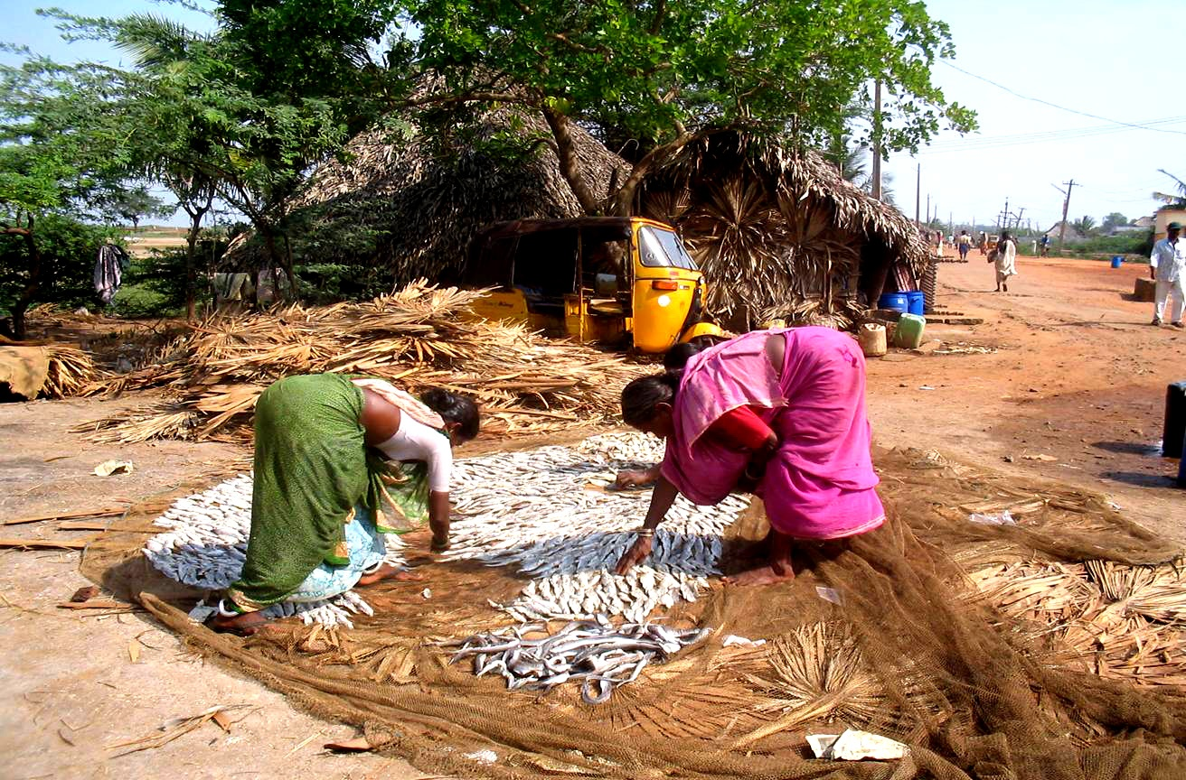
Dry fish processing

Slide 46
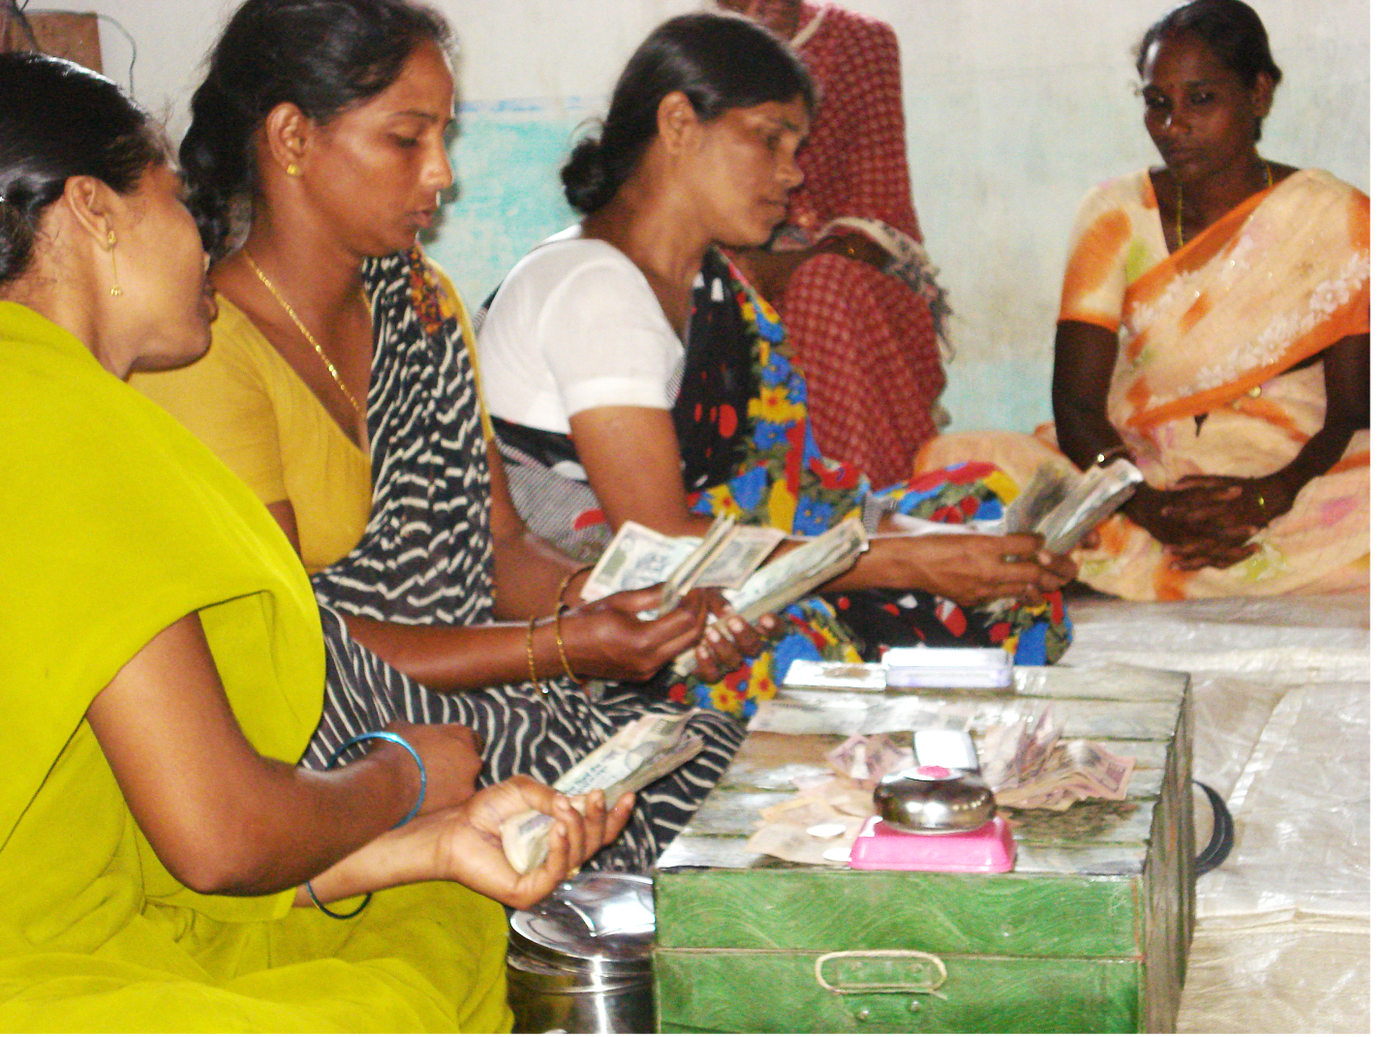
Collection in a VO meeting

Slide 47
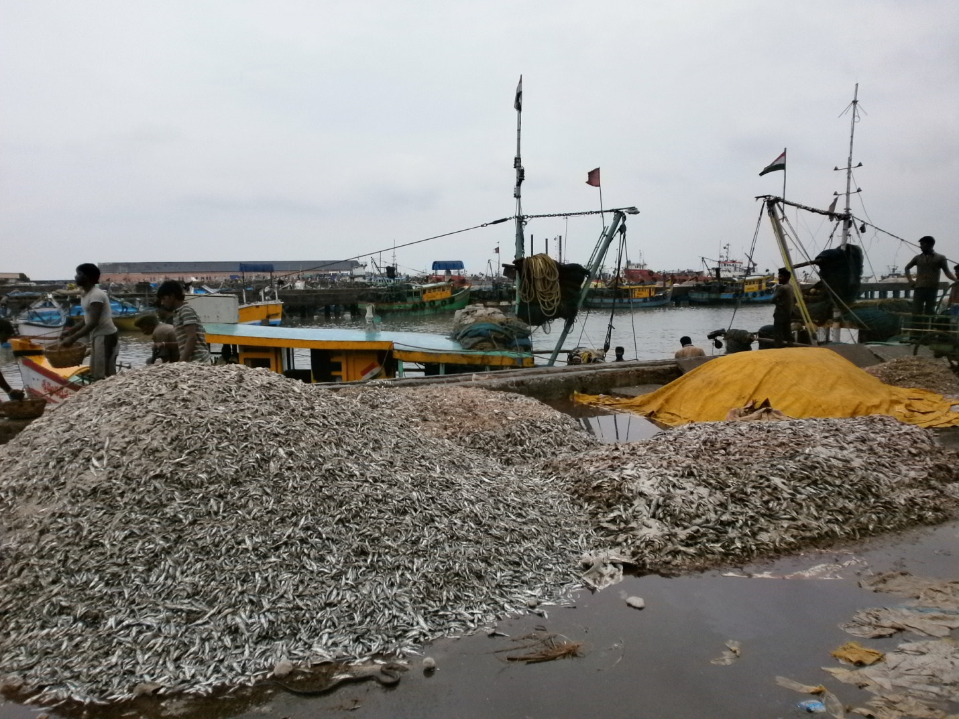
Dry fish in Kakinada port

Slide 48
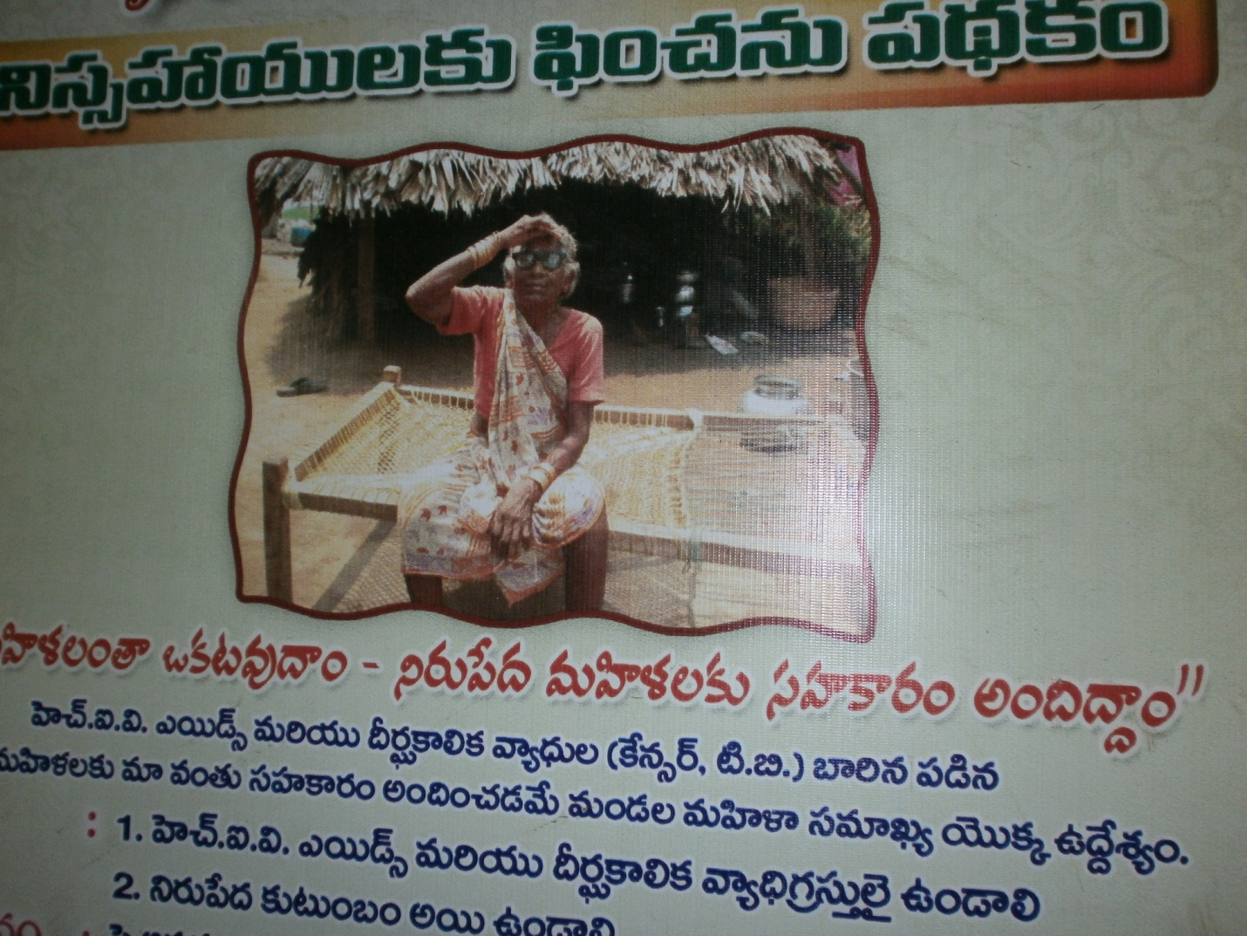
Poster depicting an old SHG woman

Slide 49
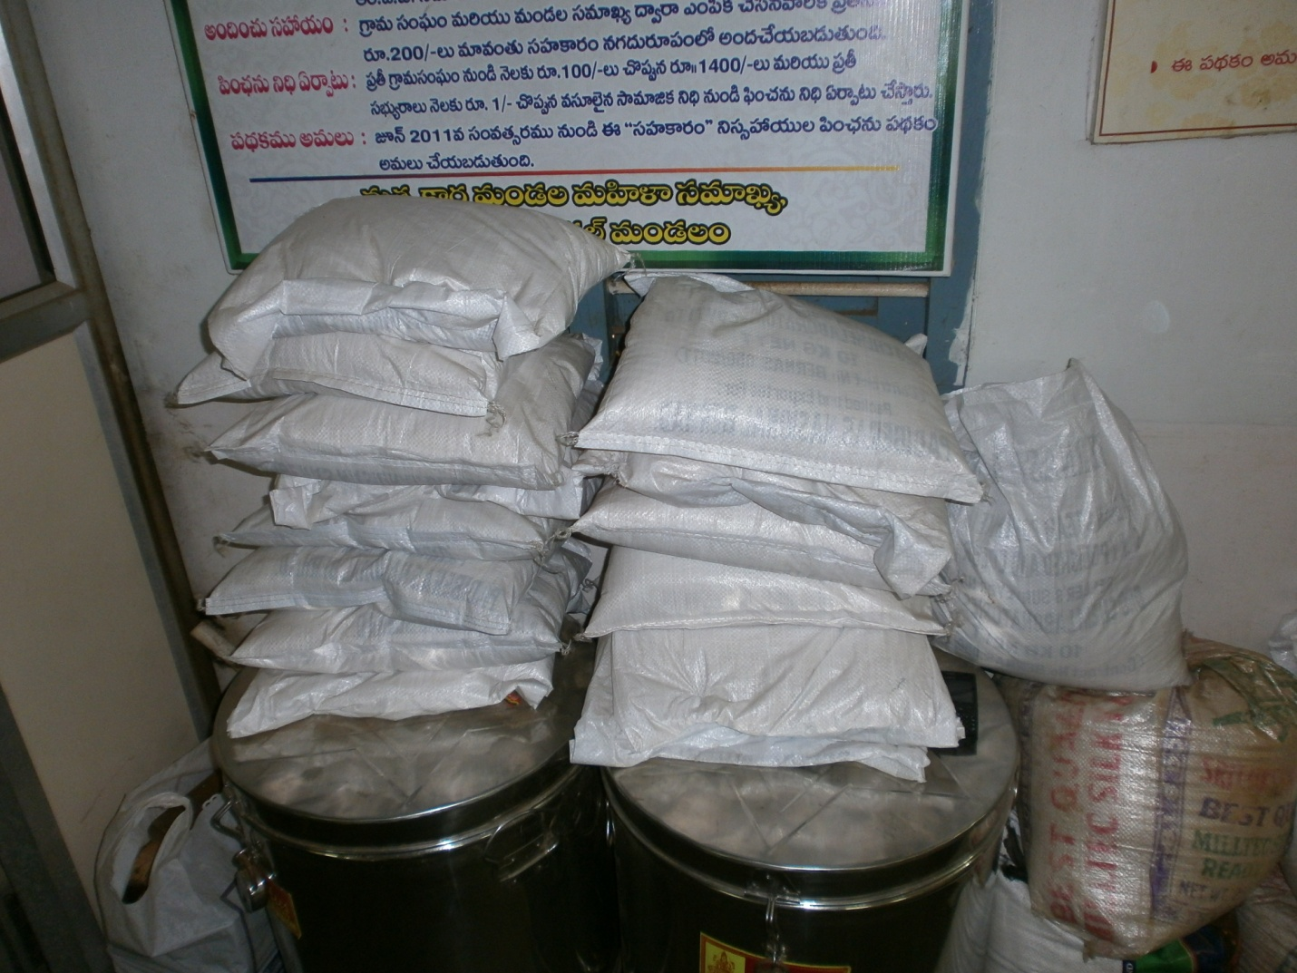
Rice for distribution among members (for livelihood support)

Slide 50
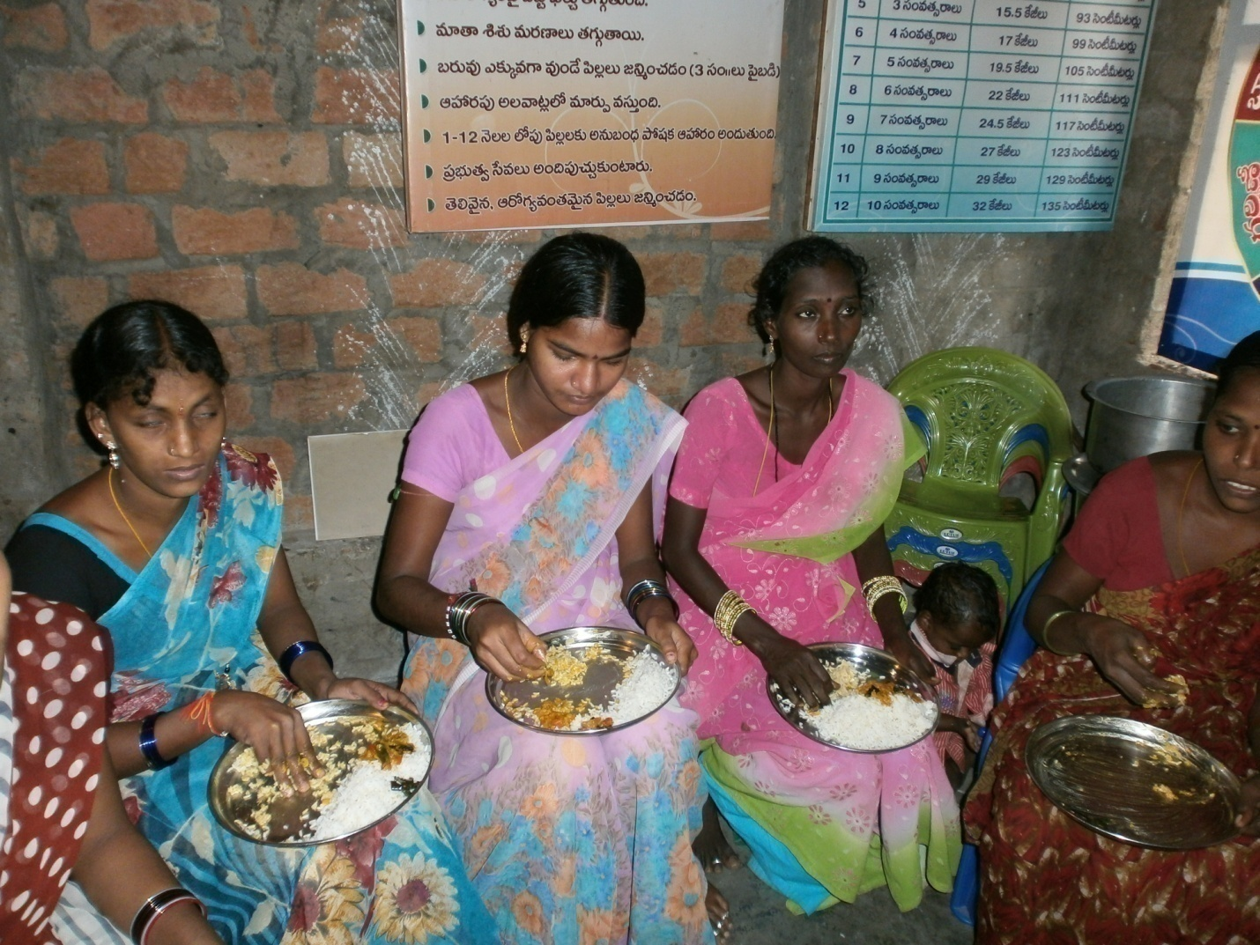
Food provided to women in Health and Nutrition center

Slide 51
About field study
Study conducted in March 2014 by visiting the district & meeting with beneficiaries.
CASE Study (case-1)
Profile of Sri Sai SHG as on 28th February 2014 (Amount in Rs)
Members of SHG started in April 2006, they meet weekly.
Village: Bhyravapalem & Mandal: I. Polavaram
( Indicators used in the study for SHGs)
No. of members : 10 & Backward caste.
No. of meetings held : 412
Percentage of Attendance : 99%
Savings frequency: weekly @Rs. 35/member/month
Total Savings : 94,460

Slide 52
Sri Sai as on 28th February 2014 (Amount in Rs) Case – contd.
Interest Collected from members : 1,51,070
Interest on Bank Balance : 444
Penalties : 480
Other Incomes : 1,500
Total Expenditure : 47,854
Net own fund in the Group : 1,05,640
No. of Loans given by the SHG to members : 375
Total Amount :14,04,335
SHG Total Turnover : 16,04,435

Slide 53
CASE Study (case-2)
Latha Bhuvaneswari SHG as on 7th March 2014
(Amount in Rs.)
No. of members: 10, Backward caste, SHG started on 18-12-2003
Name of Village: Uppalanka; Name of Mandal: Karapa
No. of meeting held : 280
Percentage of Attendance : 98%
Savings frequency : weekly- per member @Rs. 40
Total Savings : 89,064

Slide 54
Case-2-contd - Latha Bhuvaneswari SHG as on 7th March 2014
(Amount in Rs.)
Interest Collected from member : 54,629
Interest on Bank Balance : 1,050
Penalties : 1,127
Other Incomes : 3,925
Total Expenditure : 27,710
Net own fund in the Group : 33,021
No. of Loans given by SHG to members : 235
Total Amount : 15,22,930
SHG Total Turnover : 16,45,015

Slide 55
Bhavani SHG Profile as on 28-2-2014
Name of the SHG : Bhavani , MSS
No. of members : 12 Caste : BC
Name of the Village : China Valasala
Name of the Mandal : Tallarevu
Date of Starting : 14-05-1999
No. of meeting held : 496
Percentage of Attendance : 96%
Savings frequency: weekly and saving @Rs. 50/week/member
Total Savings : (Rs) 1,47,720

Slide 56
BHAVANI SHG (In Rs.)
Interest Collected from the members : 1,18,058
Interest on Bank Balance : 1,067
Penalties : 329
Other Incomes : 4,613
Total Expenditure : 33,606
Net own fund in the Group : 90,461
No. of Loans given by the SHG to members : 395
Total Amount : 15,14,355
SHG Total Turnover : 16,87,316

Slide 57
Cases from Bhavani SHG
Case – 1
Ms. K. Satyavathi 50 years, illiterate 4 children (3 sons & 1 daughter).
She borrowed 48 times small and big loans. small loans in between Rs.100 & Rs.5000 interest rate of 2 % PM.
Big loans minimum Rs.5000 & maximum Rs.40000 (interest rate 1.5% per month).
Total Loan Rs 2.39 Lakh &used for new boat and for son’s education ( engineering), daughter marriage etc.

Slide 58
Case-2
Ms. P. Ramalaxmi, 38 years, Studied upto 3rd class 4 children (1son+3 daughters)
Borrowed 33 times small & big loans, amounting to Rs.1.76 lakh
Loan used for purchase a boat & net for fishing, children’s education , 1 daughter’s marriage etc.

Slide 59
Case-3
Mrs. Nagamani (42 years, illiterate), widow
4 children (3 sons & 1 daughter) 2 sons & daughter married. Staying separately.
1 son, student was with her.
Borrowed 35 times (22 times small land & 13 times big loan) total Rs.2.24 lakh
After households expenditures constructed pucca house

Slide 60
4 more cases
Ms. P. Suryakantham,53 yrs, illiterate,11 times borrowed, Rs.0.115 million.
Ms. P. Laxmi, 45 yrs., 2nd class, borrowed 23 times, Rs 0.1 million.
Ms. K. Pentamma,45 yrs., class 1,borrowed SHG 15 times Rs. 0.1 million.
Ms. M. Ramana,45 yrs & 2 class, borrowed 27,Rs. 0.175 million.
Loans meticulously used. No misutilization of loan.
Utilisation of loans inter alia purchase of net & boat (many cases), agricultural inputs, education of children & marriage of daughters, house renovation, household needs etc.

Slide 61
SHG members taking care other aspects
Not only income generation SHG members taking other social aspects
Chinnavalasala village of Tallarevu Mandal, East Godavari district, Andhra Pradesh 10 families were given @ 5.4 kilograms of rice per family.
each SHG member who blissfully contributed rice

Slide 62
thanks
THANKS

